Slide 1
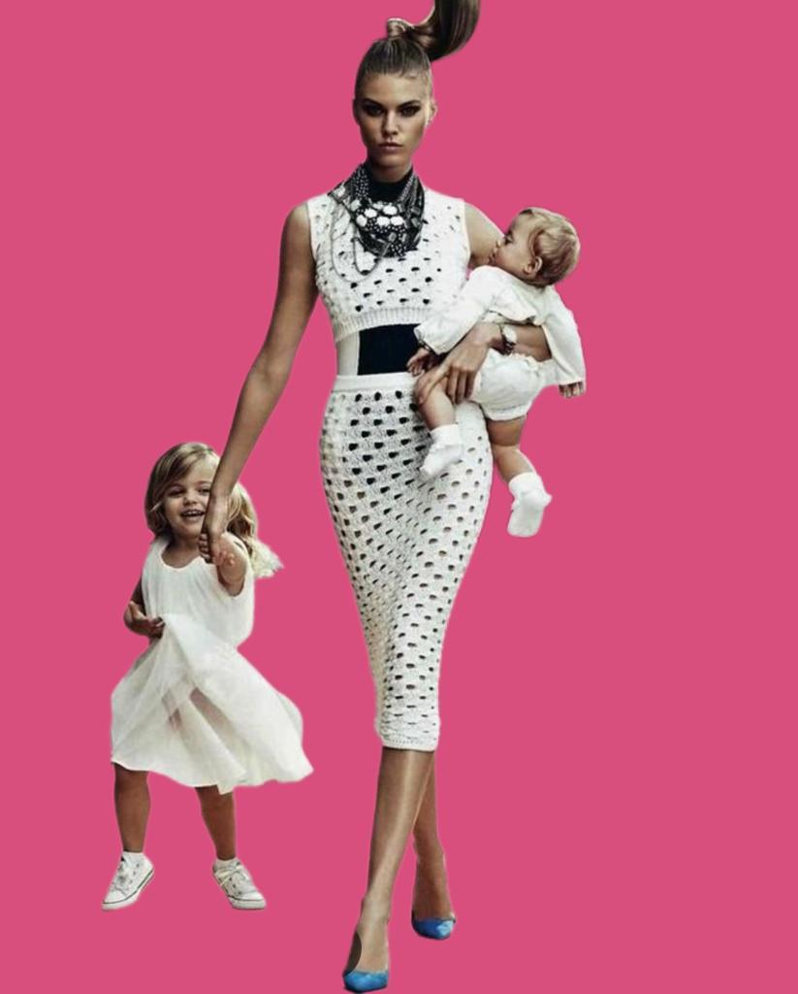
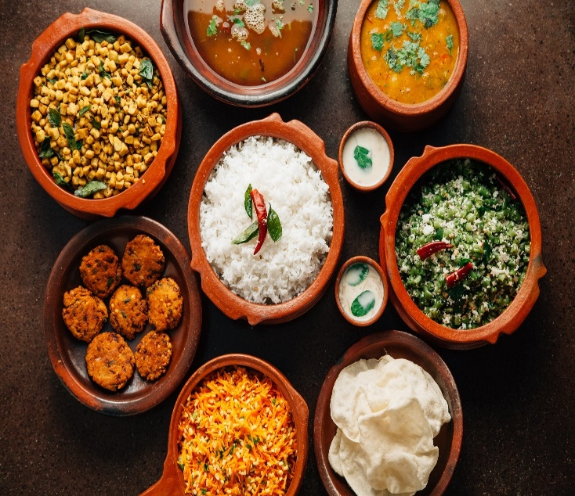
IWA Gourmet Goddess Club – Mother’s Day Special
Member: $25 Non-Member $35
Dress Code: Wear what you are/ What you want to be
Cooking Demo by Moghul Mahal Chef Lots of Fun and a Surprise Activity
Event Name: GGC Mother’s Day Special
Date : 9th May, 2023 Time : 10:30am to 2:00pm
Venue: Moghul Mahal Restaurant, 2, Tessensohn Rd, #03-01 Khalsa Association, S-217646
Contact : Anita Goenka 85332433/ Manju Banka 97245211
Registration Mandatory. Register online at www.iwasingapore.org

