Slide 1
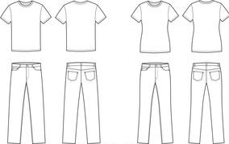
Act Of Kindness – Men’s clothes collection
AOK brings to you an opportunity to donate Men’s clothing to Workers currently residing in Singapore.
Donations must be made between 21st Feb to 1st March at the address provided above between 10:30 am to 4:00 pm.
Donations of 2-3 tops & 2-3 bottoms ONLY! This is not a donation drive as we do not have the capacity to store too much!
Items to be cleaned, ironed, sorted in separate bags and labeled as 'shirts' 'pants' etc along with members name, phone number and full address prior to depositing.
Event Name: Men’s clothes collection
Date : 21st Feb to 1st March 2021(Sat) Time : Deposit items between 10:30 am to 4:00 pm
Venue: Items can be deposited at 3 Tanahmerah Kechil Road, 17-04, The Tanamera (46664)
Contact : 98543847
Registration Mandatory. Register online at www.iwasingapore.org

